Slide 1
Web Appraisal Sprint 5
Josh Basar, Alec Breslow, Kimberly Nguyen, Matthew Peace, Brent Schapman, Brian Shuryan

Slide 2
Pre-sprint goals
Add tables in database and begin populating with actual data
Create the rest of the appraisal forms and data entry
Finish this milestone end-to-end, complete with proper testing
Begin implementing customer views

Slide 3
Where are we now?
All appraiser views are implemented complete with navigation
Database tables are all added
Appraisals are able to be created and some information can be updated
Began work on customer, read-only views

Slide 4
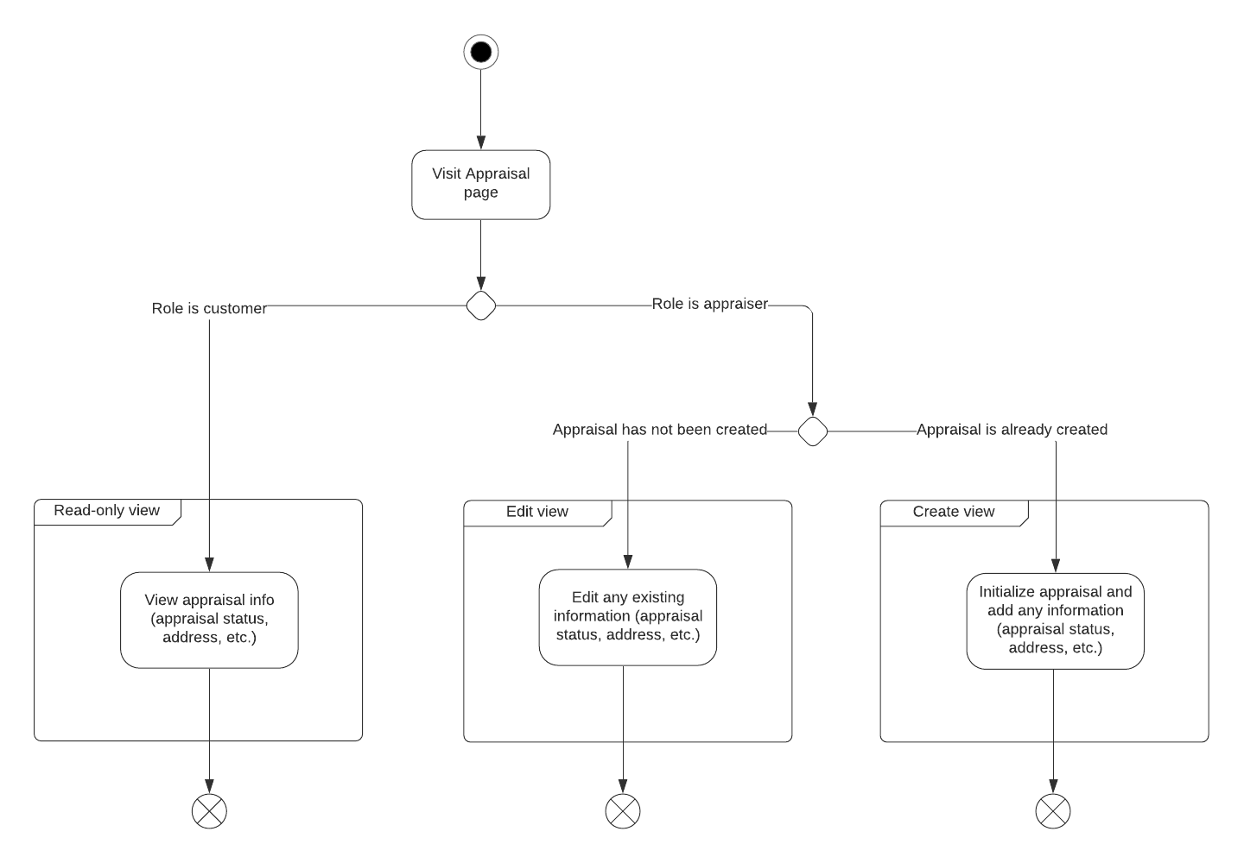
State Diagram

Slide 5
Sprint Challenges
Version control challenges when merging branches which have not been updated lately
Resulted in some code being duplicated and some deleted
Different formatting preferences in HTML code made reading/comprehending changes difficult when multiple people are working on the same code

Slide 6
Demo!!

Slide 7
Next Sprint Objectives
Finish implementing customer views
Continue working on form functionality for appraiser views
Shift more focus to mobile UI
Photo upload functionality

